Slide 1
WELCOME
Funded in part by The Coca-Cola Foundation
Notes:
On _date__, ___name__, ___name__, and ___name_ attended the Power Up for 30 training. As a team, we learned about the benefits of physical activity for the body and mind. Not only does it help make our kids healthier, but research supports physical activity also improves attendance, academics, and attention. We were sold on its benefits and created a plan to enhance what our school is already doing by adding physical activity throughout the day.

Slide 2
What is Power Up for 30?
A joint initiative supported by Georgia Departments of Education and Public Health
Integrates 30 minutes of physical activity seamlessly into the school day
Supports research connecting physical activity and academic performance
Funded in part by The Coca-Cola Foundation
Notes:
The initiative is supported by DOE and GA Department of Public Health to increase physical activity. The research is out there showing the benefits and we are excited to bring this to our school.

Slide 3
Power Up for 30 Mantra
30 minutes
Every Day
Every School
Every Child
Funded in part by The Coca-Cola Foundation
Notes:
The national recommendation of physical activity is 60 minutes per day. Since 95% of today’s youth attends school for approximately 7 hours a day, the hope is that at least 30 of these minutes will be earned while at school, if not more when adding-in Physical Education class!
Our plan is to increase physical activity through ____________________________. (please insert before/after school program, in the classroom, at recess, or school-wide physical activity program)
Before you become overwhelmed, the goal is to not interrupt your already existing day (as we know how jammed packed it is already) but to enhance what is already going on at school by adding physical activity within our already existing routines.

Slide 4
How Did Students Shape Out…?
2012 AND 2012-2013, 2013-2014 Assessment Results
Overweight, underweight, or obese
43% - 1st year
41% - 2^{nd,} 3rd year
Unable to achieve the HFZ for ANY of the Fitnessgram assessments
20% - 1st year
24% - 2nd , 3rd year
19% - 2nd, 3rd year
14% - 1st year
Able to achieve HFZ in ALL five of the Fitnessgram assessments
Notes:
From the state-wide Fitnessgram data representing over 1 million students, we see the following…
Just a little bit of background on how Power Up for 30 really began. FitnessGram is the standard measurement of testing in Physical Education. It measures 5 components: (body composition, aerobic capacity (PACER, 1 mile), flexibility (back-saver sit and reach), muscular strength (push-ups), and muscular endurance (curl-ups).
There is no PASS or FAIL, but what we call the Healthy Fitness Zone (HFZ). Through scientific research, ranges have been established for each component based upon age and gender to distinguish what is “Healthy” and therefore falling in the HFZ. The initiative is truly fueled by Georgia’s FitnessGram data from 2012 and 2012-2013 school years.
Here is how GA students SHAPE out…
the first set of FitnessGram testing components, body composition, decreased from the 1st year to the 2nd and 3rd in the percentage of overweight, underweight, and obese 4th-12th graders…this is good!
The second box (blue) looks at the students, grades 4th through 12th, increased in the percentage of students who were able to achieve the Healthy Fitness Zone in ALL 5 FitnessGram assessments. The percentage of students increased from the 1st to 2nd year/3rd , which is great, but still only 19% of students were able to achieve all 5 areas.
The third box (orange) looks at the students, grades 4th through 12th, increased in the percentage of students who were unable to achieve the Healthy Fitness Zone in ANY of the 5 FitnessGram. We would like to see the opposite happening, as if this trend continues, at least 1 in 4 students will NOT pass ANY of the 5 FitnessGram assessment components in years to come.
Data for last year’s FitnessGram testing has not been released, but should be here in the near future.
Aerobic capacity has increased slightly from 2012-2013 to 2013-2014
????Third bullet – Why do you think we are seeing this increase? One possible option is Teachers are becoming more discriminatory in test administration.
HFZ for PACER data: As compared to the 2013 data there is an increase in the percentage of students in the HFZ
for aerobic capacity for both girls and boys. Girls 1.4% increase and boys a .3% increase.

Slide 5
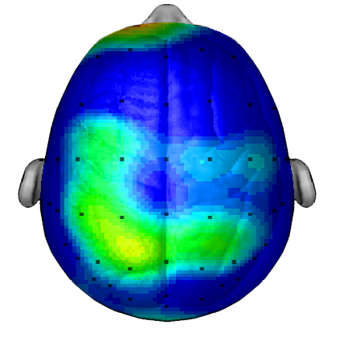
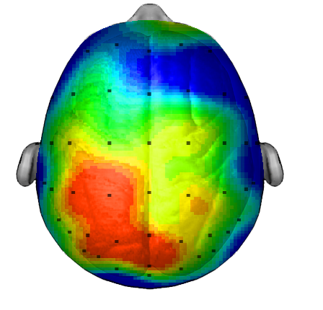
Rooted in Research
The Physical Activity and Learning Connection
Average Composite of 20 Students Taking Same Test
Brain after sitting quietly
Brain after 20 minute walk
Research/Scan Dr. Chuck Hillman University of Illinois
Physical Activity improves…
Attendance
Classroom behavior
Cognitive development
Test scores
Academic performance
Notes:
The benefits of Power Up for 30 is rooted in research…
Reference one pager Physical Activity Enhances Learning from your Power Up for 30 Training Packet– first section with brain images
The screen shows a brain scans of 20 students taking the same test. Half sat quietly for 20 minutes and the other walked for 20 minutes prior to the test. Scan shows the increase in brain activity after movement.
Additionally, the CDC did a meta analysis of the research and it shows physical activity improves…..read bottom blue boxes. Also showed that in no instance did increased time in PE/PA have a negative impact (decrease) on test scores.
http://www.cdc.gov/healthyyouth/health_and_academics/pdf/pa-pe_paper.pdf

Slide 6
Students in the Healthy Fitness Zone for Aerobic Fitness…
Scored HIGHER in Math & Reading
Had FEWER discipline referrals
And BETTER attendance
SOURCE: Cobb County Schools Fitnessgram Analysis -­‐ Relatonship between Aerobic Capacity, Academic Achievement, Attendance and Behavior.
Notes:
This data comes from Cobb County Schools (Georgia) Fitnessgram Analysis –looking at a Relationship between Aerobic Capacity, Academic Achievement, Attendance and Behavior.
This data represents grade 4th-12th and tied it to the district’s CRCT scores. Data showes that students in the HFZ for Aerobic fitness scored higher in math and reading, had fewer discipline referrals and better attendance.

Slide 7
Power Up for 30 Pilot
After One School Year of Programming
Physical Activity
Knowledge
Moderate to Vigorous PA in PE
Classroom PA Time
Before School PA Time
Notes:
During the 2013-2014 school year, 39 Georgia elementary schools ( from the following districts: Bibb, Baldwin, Henry, Jones, Monroe) were part of the pilot Power Up for 30 program to increase physical activity in elementary schools using the Coordinated School Physical Activity Program Model. The average free and reduced lunch rate was 73%.
After 1 year of programming, student physical activity knowledge, physical activity in the classroom, MVPA in PE, and before school physical activity time all increased.

Slide 8
Pilot: Aerobic Capacity Results
12.7% increase in number of PACER laps completed
N for PRE = 2,587; N for POST = 2,391
Notes:
The PACER test was administered twice through the school year to establish a Pre and Post test comparison.
As a result of the one year of programming:
Students saw a 12.7% increase in number of PACER laps completed from pre to post test.
72.6% of students assessed improved or maintained in their FitnessGram aerobic capacity assessment (PACER).
52% of students achieved the HFZ for aerobic capacity with the Pre test; where 61.7% of students achieved HFZ with the Post test---quite the jump!

Slide 9
Pilot: Body Mass Index Changes
Notes:
60.5% of students either decreased or maintained their BMI from pre to post test.
This pilot data was measured for a single year. If you look at each school on an individual level, not all of them had this type of results, but the data from all school were combined, they obviously witnessed some telling changes in fitness level from the Power Up for 30 pilot program.

Slide 10
Pilot: Teacher Feedback
“Before school programming is my success because more students wanted it. Students who would normally be late to school came early.”
- PE Teacher, Henry County
“The before school program gave students a safe place to exercise.”
- Classroom Teacher (Before School Program Facilitator), Monroe County
“The technology tools you gave us made us better teachers! It helped increase student engagement while measuring quality physical activity in our lessons.”
-PE Teacher, Jones County
“4th grade rocked CRCT!”
-Classroom Teacher and PE Teacher, Bibb County
Notes:
Here is what the Piloted Power Up for 30 school teachers had to say about the program and their schools. One administrator even lost 30 lbs from helping out with a student before school program!

Slide 11
Our Power Up for 30 Plan
Our Plan | Describe how your school will incorporate _____ activities to reach 30 min of PA for every student?
Resources | What resources will be used and how will those involved gain access to them? Best to start with a few resources and then offer more as plan progresses
When | Be concrete with start date, days per week for activity, and times
Who | Leave the door open to meet again, build support/ a team, talk, plan, and update on progress
Notes:
Remove italics and fill-in with your school’s plan details…read through and explain plans. Consider having a print out of your plan to show school members.
What plan did you choose: Before/after, classroom, recess, and/or school wide?...Will ALL students be involved from the start or is the a long-term goal? If not ALL students at first, then which students will be targeted first?
What resources will you use and how will you give access to those leading the activities (i.e. share folder on fileserver, Dropbox Folder, email, handout in staff mailbox, etc.)
When will you begin your plan and what times of day/days per week would you like to se the activity take place?
Who will you need support from? Who will help our the Power Up for 30 team in making the plan a success. Leave the door open for volunteers and the next meeting for bringing the plan “to life.”

Slide 12
Questions/Feedback
Funded in part by The Coca-Cola Foundation
Notes:
Take questions and feedback. If you should have any additional questions that you need assistance on answering, please contact padra.franks@healthmpowers.org

